Slide 1
RAID

Slide 2
Introduction to RAID
RAID stands for Redundant Array of Independent Disks.
It is a technique which makes use of a combination of multiple disks instead of using a single disk for increased performance, data redundancy or both.
The term was coined by David Patterson, Garth A. Gibson, and Randy Katz at the University of California, Berkeley in 1987.

Slide 3
Introduction to RAID
It gives you the ability to survive one or more drive failure depending upon the RAID level used.
It consists of an array of disks in which multiple disks are connected to achieve different goals.
There are seven RAID levels i.e. RAID0, RAID1,… upto RAID6.

Slide 4
Characteristics of RAID Levels
It contains a set of physical disk drives.
In this technology, the operating system views these separate disks as a single logical disk.
In this technology, data is distributed across the physical drives of the array.
Redundancy disk capacity is used to store parity information.
In case of disk failure, the parity information can be helped to recover the data.

Slide 5
RAID0
RAID level 0 provides data stripping, i.e., a data can place across multiple disks.
It is based on stripping that means if one disk fails then all data in the array is lost.
This level doesn't provide fault tolerance but increases the system performance.

Slide 6
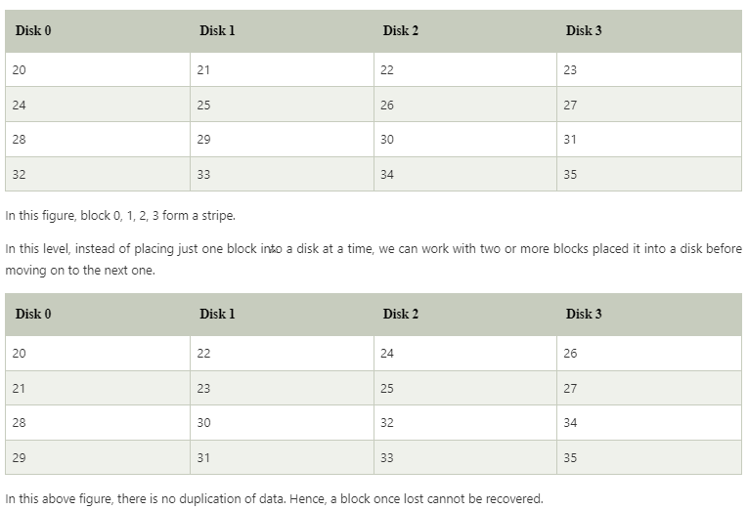
RAID0

Slide 7
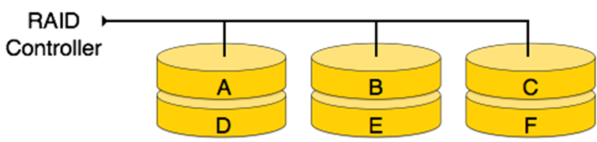
RAID0

Slide 8
Advantages of RAID0
In this level, throughput is increased because multiple data requests probably not on the same disk.
This level full utilizes the disk space and provides high performance.
It requires minimum 2 drives.

Slide 9
Disadvantages of RAID0
It doesn't contain any error detection mechanism.
The RAID0 is not a true RAID because it is not fault-tolerance.
In this level, failure of either disk results in complete data loss in respective array.

Slide 10
RAID1(mirroring)
It provides 100% redundancy in case of a failure.
More than one copy of each block is stored in a separate disk.
Thus, every block has two (or more) copies, lying on different disks.
RAID1 is capable of reliability.
It uses the concept of mirroring.

Slide 11
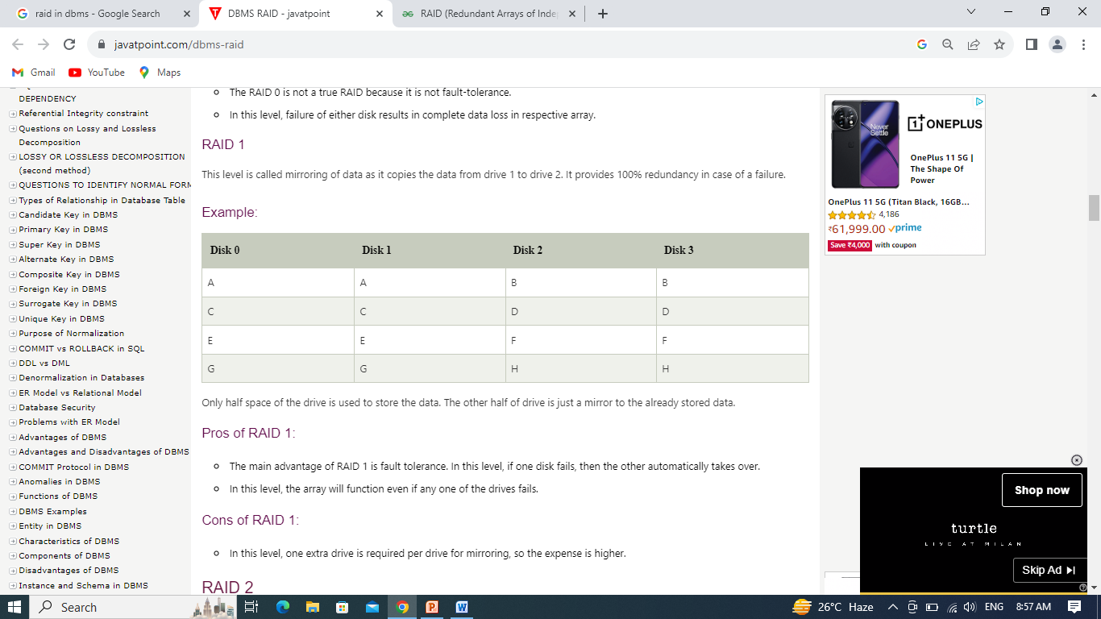
RAID1

Slide 12
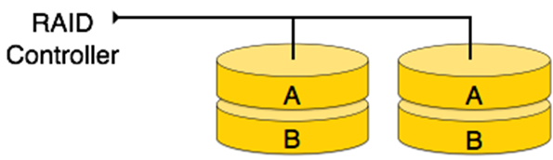
RAID1

Slide 13
Pros and Cons of RAID1
Pros:
It covers complete redundancy.
It can increase data security and speed.
Cons:
One extra drive is required per drive for mirroring, so the expense is higher.

Slide 14
RAID2
RAID 2 records Error Correction Code using Hamming distance for its data, striped on different disks.
Like level 0, each data bit in a word is recorded on a separate disk and ECC codes of the data words are stored on a different set disks.
Due to its complex structure and high cost, RAID2 is not commercially available.

Slide 15
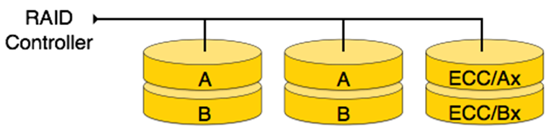
RAID2

Slide 16
Pros and Cons of RAID2
Pros:
This level uses one designated drive to store parity.
It uses the hamming code for error detection.
Cons:
It requires an additional drive for error detection.

Slide 17
RAID3
RAID 3 consists of byte-level striping with dedicated parity. In this level, the parity information is stored for each disk section and written to a dedicated parity drive.
In case of drive failure, the parity drive is accessed, and data is reconstructed from the remaining devices. Once the failed drive is replaced, the missing data can be restored on the new drive.
In this level, data can be transferred in bulk. Thus high-speed data transmission is possible.

Slide 18
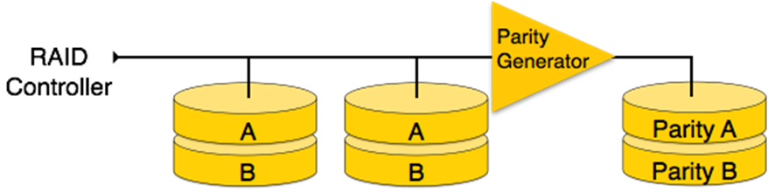
RAID3

Slide 19
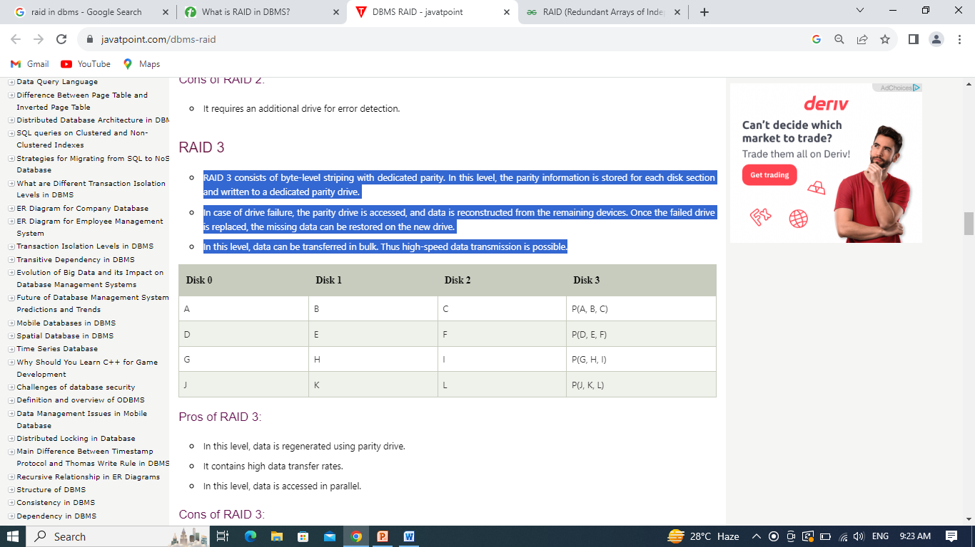
RAID3

Slide 20
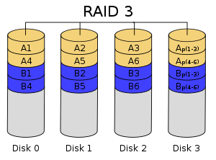

Slide 21
Pros and Cons of RAID3
Pros:
In this level, data is regenerated using parity drive.
It contains high data transfer rates.
In this level, data is accessed in parallel.
If one disk fails, we can recover data from parity.
Cons:
It required an additional drive for parity.
It gives a slow performance for operating on small sized files.

Slide 22
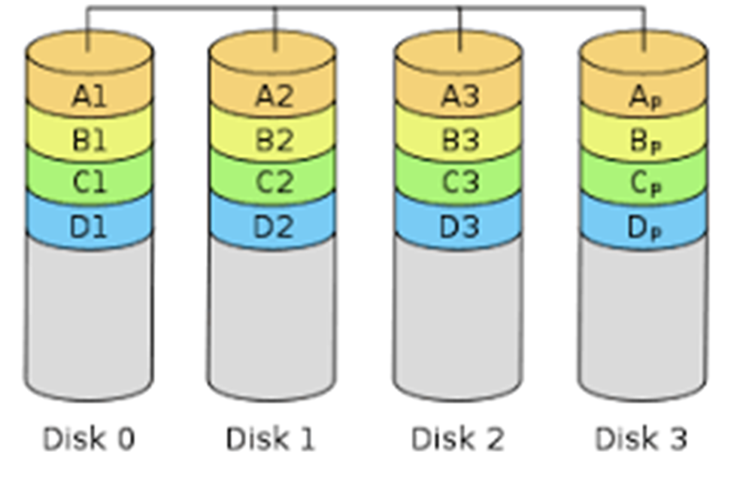
RAID4 – Striping with Parity

Slide 23
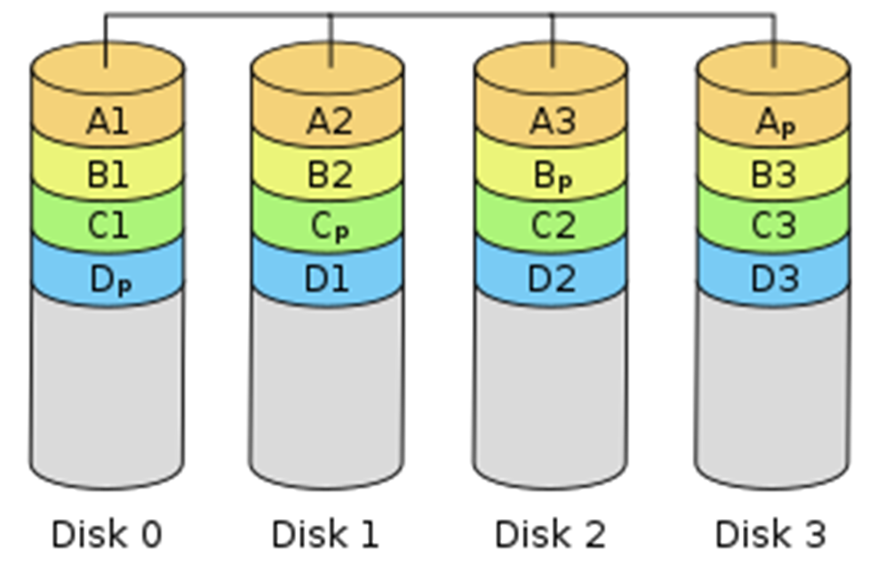
RAID5 – Striping with Parity

Slide 24
Pros and Cons of RAID5
Pros:
Read transactions are fast.
Data remains accessible even after the drive failure.
Cons:
Complex technology.

Slide 25
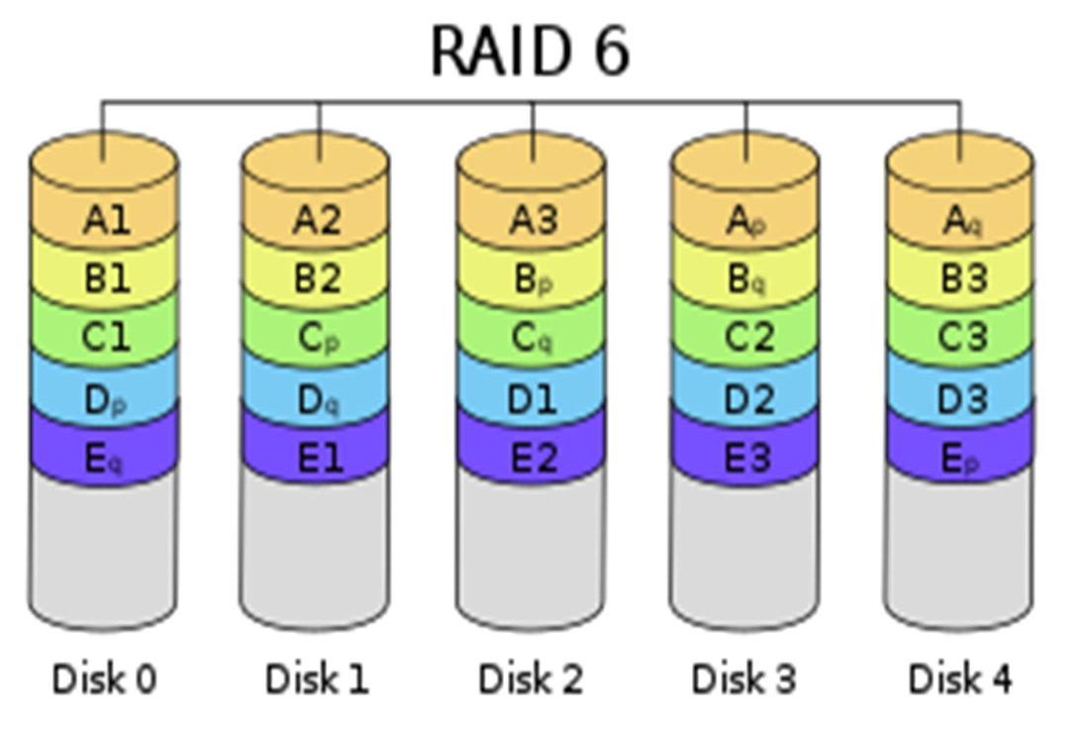
RAID6 – Striping with Double Parity

Slide 26
Pros and Cons of RAID6
Pros:
Read data transactions are very fast.
Data accessibility is high
Higher redundancy compared to RAID 5
Cons:
Due to double parity write data transactions are slow.
Rebuilding RAID array takes longer time because of its complex structure.

Slide 27
Thank You

